Slide 1
Project Daybreak
Shaping day 1 — how releases actually work today
Information security: Internal
2026-08-18

Slide 2
Paste your slides here
How this works
• Every speaker has a chapter slide with their name on it.
• Find yours, and paste your slides straight after it.
• Don't move anyone else's section — the order is the running order.
• One deck stays open all day, so nobody juggles screen shares.
Nothing polished, please
• A screenshot of the runbook beats a designed slide.
• No slides at all is fine — talk and share your screen.
• The deck is a container, not a standard to live up to.
Daybreak shaping · day 1 · Tuesday 18 August 2026

Slide 3
What we walk out with
1
The current process
Every activity from defining a release to final deployment. Including the steps that aren't written down anywhere.
2
The timing
How long each activity actually takes, and what it waits on.
3
The problems
As concrete as we can get them, then prioritized.
We are not designing solutions today. We're mapping what happens, not what's supposed to happen — where those differ, the gap is the useful part.
Daybreak shaping · day 1 · Tuesday 18 August 2026

Slide 4
If you're speaking, cover these four
The steps you actually perform
Including the undocumented ones, and the workarounds.
Roughly how long each takes
Wall-clock, not effort. Waiting counts.
The parts that annoy you
The bits you dread. Say them out loud.
Anything you do because you believe it's required
And who you think requires it. Some of those turn out to be worth checking.
Daybreak shaping · day 1 · Tuesday 18 August 2026

Slide 5
Morning — walkthroughs
09:00
Framing, and how the wall works
Majd
09:15
The map we already have
Lina Gaggi
09:30
What developers do to prepare a release
Oscar
09:50
Pre-staging and release bundles
Jins Thomas
10:10
Break
10:25
The release, end to end
Isaak Vié
11:05
The VIRP process
Yupei Li
11:20
The translation process
Yupei Li
11:35
QA during a release
Surya Paul · Marialuisa Baldi
12:00
Lunch
Times are hard. Each slot ends with five minutes for putting cards on the wall, so a 15-minute slot is 10 minutes of talking.
Daybreak shaping · day 1 · Tuesday 18 August 2026

Slide 6
Afternoon — building the map
13:00
What's actually required of us
Marialuisa Baldi
13:30
Running the PQ scripts
Ganesh Karthick Sekar
13:40
Release notes and Viedoc Learning
Rachel McKie
13:50
Break
14:00
Fill the gaps, then vote
Everyone
14:30
Walk the line
Everyone
14:50
Wrap
Majd
15:00
End
The break is short on purpose. From 14:00 everyone is on their feet at the wall for the rest of the day. We finish at 15:00.
Daybreak shaping · day 1 · Tuesday 18 August 2026

Slide 7
How we build the map: the release line
One line across the wall, from "we're doing a release" to "it's live everywhere". It gets built all day, not at the end.
While someone talks
Everyone writes cards for what they hear. One activity per card.
When they finish
Five minutes to stick them on the line, in the row for whoever does it.
By lunch
Most of the map exists. Wrong and missing is fine — that's the afternoon.
14:00
Everyone at the wall, filling in what the talks didn't cover, then voting.
14:30
Walk the whole line out loud and fix it, top to bottom.
Rows are who does the work — Platform, Development, QA, Product, Translation, Release & Response, everyone else. The wall is open all day: add a card whenever one occurs to you, lunch included.
Daybreak shaping · day 1 · Tuesday 18 August 2026

Slide 8
The wall
Columns are when, rows are who. The phases and steps are Viedoc's own, off Confluence — we're not inventing structure today.
Two blank rows on purpose. A row still empty at the end of the day is a finding, not untidiness.
Phase 1
Active development
Phase 2
Release stabilization
Phase 3
Qualification
Phase 4
Go live
What's in the release
Steps 0–8 — code freeze · translations · configuration report · bundles · regression
Step 9 handover · stage · IQ / OQ / PQ · approvals
Training and production, 9 environments · VIRP · down-merge
Product
Development
Translation
QA
Platform / IT
Release & Response
Support / PS
Approvers
(blank)
(blank)
How long
one duration per column, totalled during the walk
Daybreak shaping · day 1 · Tuesday 18 August 2026

Slide 9
What goes on a card
What happens
Verb first. "Start the workers", not "worker startup".
Start the workers
Isaak
? hours
By hand, on every machine
Who does it
A name, not a team. Names show where the single points are.
How long
Wall-clock, not effort. Ten minutes of work spread over two days is two days. Nobody knows yet? Put a question mark — that's the whole point of today.
A person does it
It's automatic
Waiting on someone
Hurts, or nobody knows
Daybreak shaping · day 1 · Tuesday 18 August 2026

Slide 10
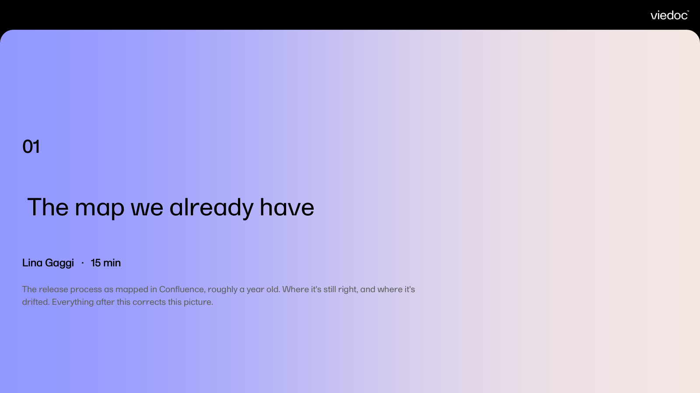
Five rules
1
Undocumented steps count double.
The ones that aren't written anywhere are the whole point of today.
2
Disagreement goes up as two cards.
Don't resolve it at the wall. Two people running the same step differently is a finding.
3
Waiting is a step.
"Sat in someone's inbox for three days" gets its own card.
4
Nobody knows? Write the question.
A coral card with a question mark is worth as much as an answer.
5
No solutions on the line.
Ideas go on the sheet by the door. Thursday is for fixing.
Daybreak shaping · day 1 · Tuesday 18 August 2026

Slide 11

The map we already have
Release Lock
Sprint
1
2
3
4
Dept
Dev
Communication prep
Regression prep
IT Handover
Deploy to Ext
Regression
PQ
Translation
Write RN
PM
Sharepoint prep
Update Website
Compile VIRP
Publish eL
Internal communication
Internal training
Update Website
PQ documentation
Training materials
Send release email
GTM materials
G2M activities
Marketing
PS
Smoke test
Release videos
IT Ops
IT Takeover
Deploy to Stage
IQ/OQ
Go Live
Runbook
Upload VIRP
QA
Approve PQ documentation
Approve the release
Daybreak shaping · day 1 · Tuesday 18 August 2026

Slide 12
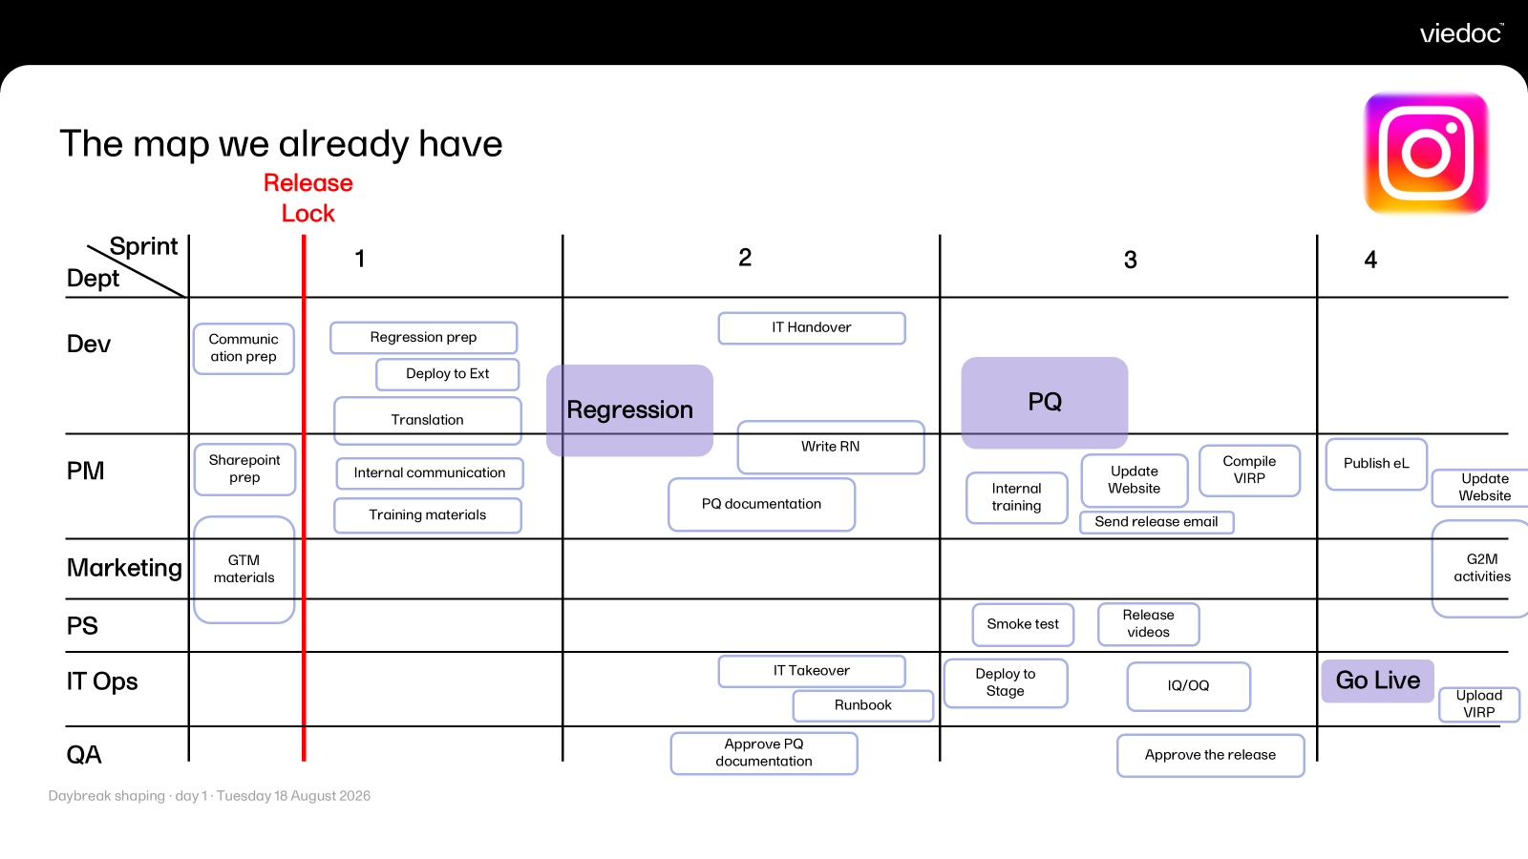
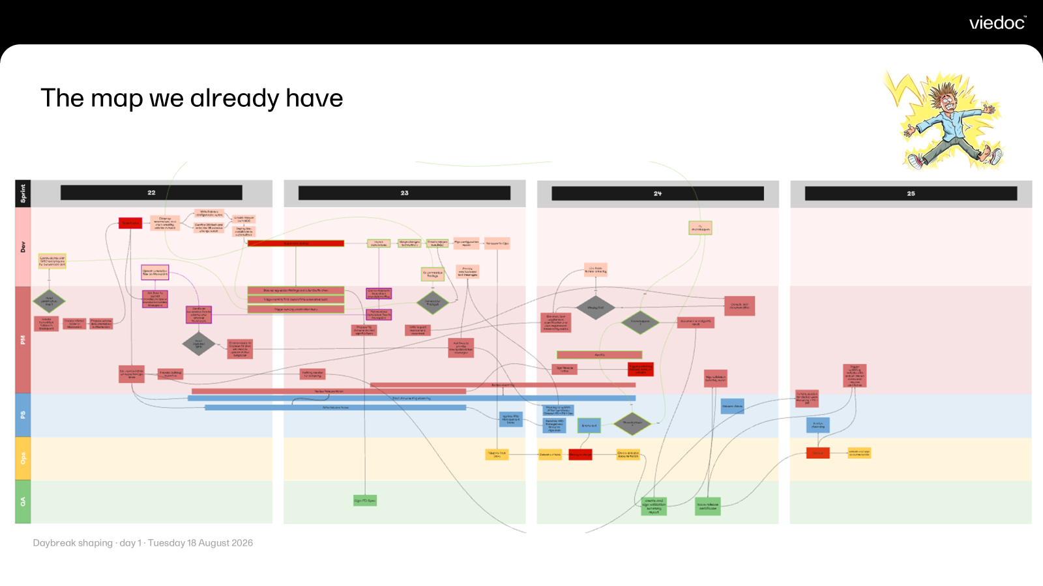
The map we already have
01
Lina Gaggi · 15 min
The release process as mapped in Confluence, roughly a year old. Where it's still right, and where it's drifted. Everything after this corrects this picture.

Slide 13
What developers do to prepare a release
02
Oscar · 20 min
Everything on the dev side before anything reaches staging — code freeze, the SQL and migrations, the ADO trail, the parts of the release documentation devs fill in by hand. Including the ones nobody's sure are still read.

Slide 14
What developers do to prepare a release
[1] Before release lock
  Fill out all necessary information in Azure DevOps and review.
    Problem: There’s lots of manual steps here and the requirements are not always clear so it’s easy to make mistakes that aren’t caught until much later.
  Verify all code for related work items is merged.
    This includes infrastructure-related code in repos such as “Terraform”, “AG”, “DNS”, etc.
[2] Release lock
  Update assembly version (depending on repo).
  Create release branch in each relevant repo (Releases/*).
    Note that we do not do this for most/all of the infrastructure repos (except the repo called “Infrastructure”, which mostly contains deployment pipelines).
  Give a status update in release channel on Teams.
Daybreak shaping · day 1 · Tuesday 18 August 2026

Slide 15
What developers do to prepare a release
[3] Regression testing
  Keep track of the regression testing post and table on Teams.
  Investigate, fix, and merge fixes for bugs into release branch.
  Communicate regarding necessary re-bundling and deployment to externaltest.
[4] Translation updates
  Extract resource keys from relevant repos (I’m not sure how this process looks today across all repos).
  Upload to SharePoint.
  Communicate in translation post in Teams.
  Once translation is complete, update the repo (release branch + downmerge).
Daybreak shaping · day 1 · Tuesday 18 August 2026

Slide 16
What developers do to prepare a release
[5] Release configuration report & handover to Platform
  Manually fill out the information for the release configuration report + checklist in Confluence.
    Sometimes more of a step-by-step runbook if necessary.
    Sometimes includes manual SQL scripts that have to be run as part of the release.
    This can include a snapshot of changes that will be applied to our databases, but I’m unsure if anyone reviews this or who this is for.
  Attend handover meeting and discuss plan for release.
[6] Git tag release branch
  Git tag release branch in repository in Azure DevOps. Note that this is not a mandatory part of our process (as far as I know) and not followed consistently.
Daybreak shaping · day 1 · Tuesday 18 August 2026

Slide 17
What developers do to prepare a release
[7] Release to stage
  Keep track of post in Teams and Application Insight logs in Azure and be ready to support.
    Problem: No access to anything except Application Insight resources for non-DEV environments in Azure so the ability to support is very limited and usually has to be done through Isaak.
[8] Release to production
  Keep track of post in Teams and Application Insight logs in Azure and be ready to support.
    Problem: Same problem as stage (lack of access) and no ability to check the logs in China unless you have an account, which most developers don’t have / we have no set process for how to get?
Daybreak shaping · day 1 · Tuesday 18 August 2026

Slide 18
What developers do to prepare a release
Open questions about DB migrations I’m unsure about myself:
Are all database migrations fully automated or are some still applied manually?
How is the Viedoc.Worker involved in the database migration for the ‘viedoc’ database today?
Do all repositories that use EF Core handle database migrations in the same way?
Daybreak shaping · day 1 · Tuesday 18 August 2026

Slide 19
Pre-staging and release bundles
03
Jins Thomas · 20 min
What goes into each package, how that gets decided, and when. Plus the pre-staging steps that come before a release.

Slide 20
Pre-staging & release bundle – Main Steps (1/2)
  Code Freeze
    Release branch creations
  Call for Translations
    Send the translations to translation company
  Bundling Strategy
  Create Bundles
  Release Config Report
    Bundle details
    DB change details
    Infra changes
    Secrets & DB hash details

Slide 21
Pre-staging & release bundle – Main Steps (2/2)
  Clean External & Deploy for Regression Testing
    Confirm DB changes
    Calculate DB hash
  Initiate the regression testing
  Fix bugs if identified
    repeat build & deploy cycle
  External controlled by R n R team during regression
  Import Translations
    Redeploy to External for Review
  Down merge changes from Release branch to dev/main(last minute changes and translations)

Slide 22
The release, end to end
04
Isaak Vié · 40 min
The release as you actually run it — picking up from pre-staging and continuing past production deployment. And what you understand is required of you.

Slide 23
Platform Release Process: Handover to Production
1 PREPARATION Triggered once regression and testing is complete
1 · Handover meeting
All team leads and platform · triggered when regression and testing is done
Organised by Jins · 30 min
2 · Runbook for operations
Time driven by handover doc quality and chasing for clarifications
Isaak · 1h – 1 day
3 · Infra & manual steps
Scope depends on release content and handover documentation
Svanty + Isaak · 1–10h total
2 STAGE IQ / OQ documentation is produced while PQ runs in parallel
4 · Release to stage
Duration depends on the issues encountered on the day
Isaak + Svanty · 1h – 1 day
5 · Stage IQ & OQ
IQ automated via pipeline; OQ semi automated bar 3 manual screenshots
Isaak · up to 1h · DocuSign ×2
6 · PQ & green light
Release to prod starts only once PQ is done and signed off
Done in parallel with stage docs
3 PRODUCTION 4 regions × 2 environments · training in the morning, prod after lunch
7 · Release to prod
8 environments, two pairs of eyes on every one
1–4h per env · China can take up to 1 day for 1 env
8 · VIRP pipeline
Prepped and pushed manually after each prod/training release
Isaak · 30 min
9 · Sanity check
PS volunteer sourced via the release teams channel
Duration unknown - Ad hoc
10 · Prod IQ & OQ
One IQ + OQ per prod env (not training)
Isaak · total 3h (DocuSign x2)
In case of a hotfix, the steps need to be repeated
The OQ SOP does not ask for screenshots — only the template does. Fixing that unlocks full IQ/OQ automation, leaving DocuSign as the only manual step.

Slide 24
What Are The Manual Steps, You Ask?
MANUAL TOUCHPOINTS IN ONE RELEASE
Before the release
Gather schema.xml for Jins
Turn fragmented handover documents into one end-to-end cookbook
Book PFT members for release sessions in Outlook
Deploy infrastructure in Terraform
Manual release steps pre-release: secrets, whitelisting, change SKUs and instance counts
Run the database queries that must happen in advance, and log the results
Run the "current IQ" pipeline in preparation
Announce the start in the release channel and tag individuals
During the release
Copy-paste branch + bundle info into the release-bundle pipeline, then run it
Switch to all.deploy: approve each step, restart the ones that fail
Run the mid-release database queries at exactly the right moment — or else!
Stop the old version workers on every virtual machine (that is 5 machines in FR!)
Run the now infamous "Viedoc.Worker.exe -RT UpdateDatabase"
Start the newly deployed workers on all VMs again!
Check everything works once the pipeline completes (OQs, manual login)
After the release
Announce again, tag individuals again, ask PS for a sanity check
Upload the handed-over VIRP to its repo and run the pipeline
Run the IQ pipeline to generate the IQ document
Generate the OQ document (script), then fetch three extra screenshots by hand — AG health, AZ RTSM Insights health, and local RTSM via an app server login
Collect the documents in SharePoint and DocuSign
Every one of these is a place the release can stall.
Several steps have to land at an exact moment or the release breaks.
The steps in the middle column need to be repeated for each bundle, e.g. main, others, coder, etmf etc.

Slide 25
Where Release Time Goes
COST OF ONE RELEASE
1 day
stage release
5 days
production and training across 4 regions
6+ days
end to end, before handover prep
2 people
Isaak and Svanty engaged almost throughout
WHAT WE SEE TODAY
Where release time goes
Duration scales with the type and complexity of the release
Manual steps — above all backend database operations requiring logs to be extracted and kept
Pipeline chain is complex (release-bundle → all.deploy) and still relies on copy-pasting bundle numbers
Pipeline speed on the day sits outside our control
Pipelines are fairly sequential
Begin/end steps (deployment tags) takes 1-2 minutes each, adding up over an entire run
Issues found during release delay the process
Quality upstream sets the pace
Ops runbook creation depends heavily on the quality of the documentation handed over by dev teams
Issues found late — from stage onwards — happen too often and create avoidable delays

Slide 26
Where to Focus
Quick wins · less friction and risk, small time gains
Minimise unnecessary manual steps during the release itself
Improve handover documentation quality so runbook creation stops stalling on chasing clarifications
Platform will liaise with QA to formalise acceptable evidence to fully automate the OQ document
One standard announcement per release step in the channel, no individual tagging required
Agree what we monitor per environment, and who owns it
Structural plays · the only route to one-day releases
Raise the quality bar at handover — code must arrive tested and verified against a defined exit standard
Test earlier and deeper — so defects surface in dev, not late
Rework the pipelines — reduce complexity, not just the copy-paste
Release regions in parallel, not eight environments in sequence
Food for thought:
- The quick wins remove friction and risk, but together they shave only a couple of hours off the whole release. They will not turn a six-day release into a one-day release.
- A one-day release is a structural target which will require a sustained effort.

Slide 27
The PQ and VIRP process
05
Yupei Li · 15 min
How VIRP works and where it sits in the release flow. Generation and deployment are both manual today.

Slide 28
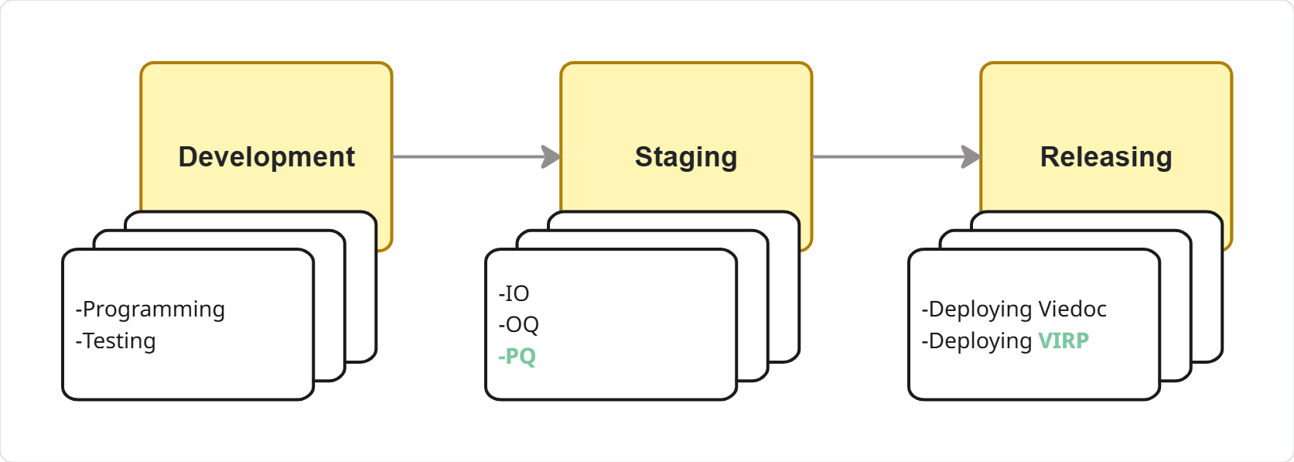
The PQ process
2 documents
One of them can only be completed after Staging
PQ takes normally 3 days
PQ Specification & Sign-off
Step | Description | Time | Problem | Painpoint | Must do/Required
1 | Prepare PQ specification file (~1 week before Staging). Doc ID & names updated manually; Claude Skills used; including content check. | ~40 min | Doc ID and names must be updated by hand every time. | Repetitive manual entry despite Claude Skills; time lost on formatting, not content. | -
2 | Share file with Ganesh to review / request changes. | Hard to timebox | No fixed turnaround time for feedback. | - | Feedback must be incorporated before signature.
3 | Send final file to QA Manager & CPO for signature. | Hard to timebox | Signature timing is outside process owner's control. | - | Both signatures required before archiving.
4 | Archive the signed file to the Release Binder SharePoint folder. | Manual | Manual filing step, no automation. | Purely administrative, repetitive filing work.. | -
Daybreak shaping · day 1 · Tuesday 18 August 2026

Slide 29
The PQ process
2 documents
One of them can only be completed after Staging
PQ takes normally 3 days
PQ Results & Sign-off
Step | Description | Time | Problem | Painpoint | Must do/Required
5 | Prepare PQ result document reflecting the PQ specification. Doc ID & names updated manually; Claude Skills used; including content check. | ~40 min | Same manual ID/name updates as Step 1 — duplicated effort. | Redundant manual work mirroring Step 1's problem. | Result doc must accurately reflect the specification.
6 | Call out PQ testing team to perform PQ per specification once Staging is done. PQ test | ~2-3 days | - | - | Must be done after Staging.
7 | Project-manage PQ progress; provide solution and support when needed. | Hard to timebox | Ad hoc, reactive support with no defined scope. | Critical issues can be identified at this point, which normally impact the release cadence and could mean reverting work already completed. | Issues during PQ testing must be resolved to keep progress.
8 | Send final PQ result to CPO for signature. | Hard to timebox | Same signer-dependency issue as Step 3. | - | -
Daybreak shaping · day 1 · Tuesday 18 August 2026

Slide 30

The VIRP process
13 documents, done by different roles
No strict timeline but a clear deadline
Two of them can only be completed after PQ
Normally a week
Static Filing & Form Docs
Your slides go here
Paste after the chapter slide before this one, then delete this slide. No slides is also fine.
# | Document | Description | Working Steps | Painpoint | Must do/Required
1 | VIRP Introduction | PDF · static unless VIRP content changes | Manually added to the VIRP SharePoint folder every release. | Purely manual, repetitive administrative work | -
2 | Clinical Trial Cloud System Checklist | Doesn't change often | Manually added to the VIRP SharePoint folder every release. | Purely manual, repetitive administrative work | -
3 | Acknowledgement Form | Word doc · fairly static Content and file name both need the release number. | File name and ID is done manually. Content updated using Claude Skills. Upload to SharePoint manually. | Purely manual, repetitive administrative work on getting the right file name and uploading it to SharePoint. | -
4 | VIRP Change Summary | Word doc · fairly static (conditional) | Content and file name need the release number updated, this is done by Claude Skills. if changes were made to a published VIRP, the summary must reflect those changes too. | When published-VIRP changes exist, updating takes ~30+ min due to back-and-forth communication to confirm what changed. | -
Daybreak shaping · day 1 · Tuesday 18 August 2026

Slide 31
The VIRP process
13 documents, done by different roles
No strict timeline but a clear deadline
Two of them can only be completed after PQ
Normally a week
Time consuming, error-prone Docs
Your slides go here
Paste after the chapter slide before this one, then delete this slide. No slides is also fine.
# | Document | Description | Working Steps | Painpoint | Must do/Required
5 | User Requirement Specification (URS) | URS information retrieved from ADO via Report Generator | File name and ID is done manually. Provide right scope and information in Report Generator to generate report. Review the content. Send for signature. File in SharePoint | Content isn’t ready to be published as generated; needs endless reminders and back-and-forth chats to get the right one. Poor documentation in ADO. Bug in Report Generator. Downtime in Report Generator. Unclear ownership of Report Generator. | -
6 | User Requirement Traceability Matrix (URTM) | URTM information retrieved from ADO via Report Generator | File name and ID is done manually. Provide right scope and information in Report Generator to generate report. Review the content. Send for signature. File in SharePoint | Purely manual, repetitive administration work | -
7 | Impact Assessment spreadsheet | Spreadsheet manually populated by PMs. | File name and ID is done manually. Fully manually populated by PMs. Manually upload to SharePoint | Purely manual, repetitive administration work with ad-hoc communication needed to move it forward. PM is not sure if this document is required and a must in VIRP. | -
8 | Release Note | Release Note information retrieved from ADO via Report Generator | File name and ID is done manually. Auto-generated, but content needs checking and reformatting. | See the “Release Note and eLearning” session | See Release Note and eLearning session
Daybreak shaping · day 1 · Tuesday 18 August 2026

Slide 32
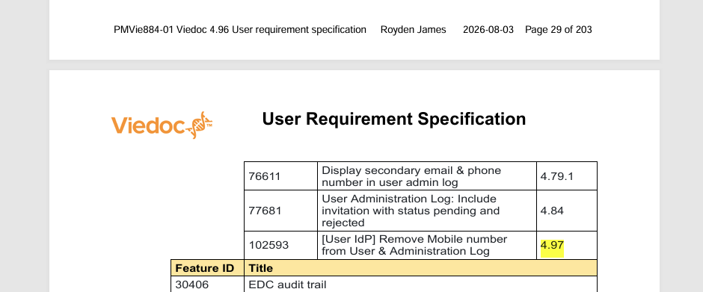
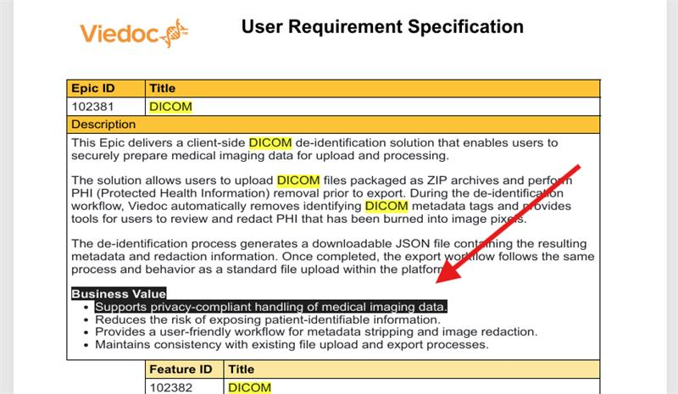
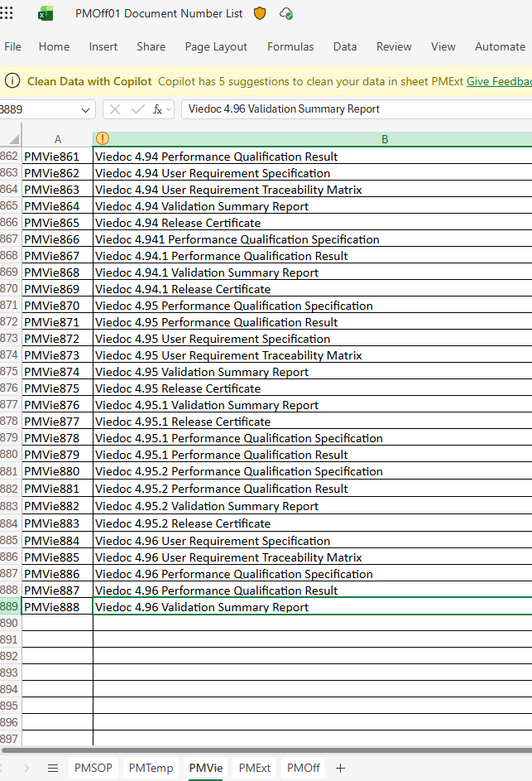
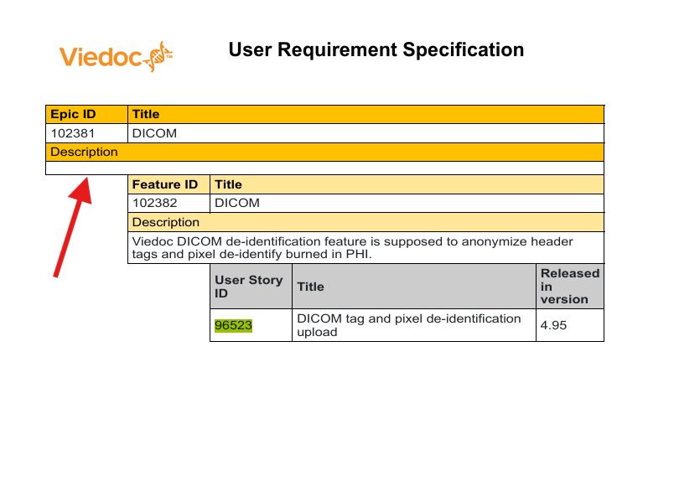


Slide 33
The VIRP process
13 documents, done by different roles
No strict timeline but a clear deadline
Two of them can only be completed after PQ
Normally a week
Other QA documents
# | Document | Description | Working Steps | Painpoint | Must do/Required
9&10 | EDC Management sheet (EN + JP) | Manually maintained and reviewed, in two languages, by both PC and QA. | Manually maintained and reviewed Upload to SharePoint | See the “QA during a release” session later | See the “QA during a release” session later
11 | Quality System TOC | Auto-generated from PT, but new SOPs need manual highlighting | Auto-generated from PT, but new SOPs need manual highlighting | See the “QA during a release” session later | See the “QA during a release” session later
12 | Validation Summary Report | Manually drafted report; requires signature. Can be completed after the PQ results are available. | File name and ID is done manually. Manually drafted after PQ results are available. Sent for signature. | See the “QA during a release” session later | See the “QA during a release” session later
13 | Release Certificate | Manually drafted | File name and ID is done manually. Manually drafted. | See the “QA during a release” session later | See the “QA during a release” session later
Your slides go here
Paste after the chapter slide before this one, then delete this slide. No slides is also fine.
Final VIRP package is generated then sent to IT for deploying
Daybreak shaping · day 1 · Tuesday 18 August 2026

Slide 34
The translation process
06
Yupei Li · 15 min
How it works now, where it sits relative to code freeze and staging, and what the prototype process would change.

Slide 35
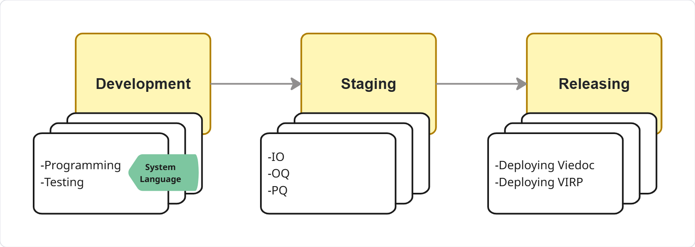
The translation process
Undergoing transition to an AI-assisted translation platform (Called Lokalise)
Technically feasible after running two pilots with Lokalise
Few blockers to address
Processes are being developed
Normally take one and half weeks, most time on reviewing, communication
Daybreak shaping · day 1 · Tuesday 18 August 2026

Slide 36
Background
Current process under PMSOP05 Localization, and what the process looks like with Lokalise
Current Process (Conversis)
Future Process (Lokalise)
① Code freeze
Dev team
① Code freeze
Dev team
Call for translation
Each team pushes keys to Lokalise
▼
▼
② Export keys
Dev team
② AI translation
Lokalise
Developers push files to SharePoint
Keys translated automatically
▼
▼
③ Quote approval
PM
③ Review & validate
Product team
PM reviews and approves Conversis quote
Team reviews and validates translation
▼
▼
④ Translation
Conversis
④ Import to ADO
Dev team
Conversis translates (~5 business days)
Reviewed files imported to Azure DevOps
▼
⑤ Files returned
Conversis
✓ No SharePoint · No middleman
Translation + certificates → SharePoint
✓ Flexible: teams work independently
▼
⑥ Import to ADO
Dev team
Potentially automated end-to-end
Developers import files to Azure DevOps
Lead time: ~5 business days

Slide 37

Proposed Translation Process
End-to-end workflow for each product team
1
2
3
4
5
Pre-Translation
Communication
Key Tagging
& Push
AI Translation
Human Review
Import to ADO
Confirm which languages are supported per product. Share updated language list with Product Communicator.
Developers tag new/changed translation keys and push them to the corresponding Lokalise project. New languages require setup verification before first push.
AI translates tagged keys, referencing Translation Memory for consistency. Note: automated workflow not yet implemented — translation triggered manually for now.
Reviewer validates translation. Must understand the language. In-house resources (JP, CN confirmed). Others TBD — see interim plan.
Reviewed translations imported back to Azure DevOps.
Interim: in-house reviewers (JP & CN confirmed) + PTE partner (pending) + Conversis as fallback

Slide 38


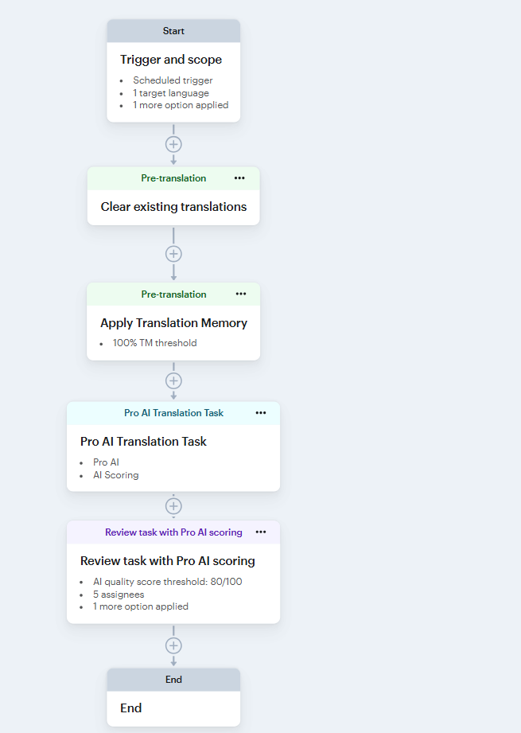
Platform Status
What is set up, what is pending, and what are the known limitations?
Completed setup
In progress / pending
Language codes configured and verified against Translation Memory (TM) files
Custom language codes aligned with Azure DevOps file naming conventions
General AI translation guide in place for reviewers
Translation workflow verified: keys can be pushed, translated, reviewed, and imported
Automated review workflow not yet implemented — requires review resources to be confirmed first
PTE partner: Lokalise shortlist questionnaire submitted 2 weeks ago — awaiting response
Fallback plan: Conversis remains available if PTE partner is not confirmed in time
Viedoc.SdvManager | Lokalise

Slide 39
QA during a release
07
Surya Paul · 10 min
What QA does across a Viedoc release — The Validation Summary report, maintaining and updating reg and quality documentations, running the regulatory suite and signing off reports and release certificate

Slide 40
QA during a release
Surya Paul
Provide oversight of the overall release activities to ensure they are performed in accordance with established procedures and that Viedoc meets applicable regulatory requirements and expectations.
In practice this includes:
Performing the regulatory part of PQ testing, ensuring compliance with applicable regulatory req and expectations
Preparing, reviewing and signing the Validation Summary Report
Maintaining and updating relevant regulatory and quality documentation, including
  QMS Table of Contents
  EDC Management Sheet as requested by JP to support PMDA submissions
  Clinical Trial Cloud System Checklist, ensuring it remains up to date with the checklist issued by PMDA
Reviewing and signing off the URS, PQ specification and validation report
As the final step, signing the Release Certificate which provides the formal 'go' for release to production
Daybreak shaping · day 1 · Tuesday 18 August 2026

Slide 41
What's actually required of us
08
Marialuisa Baldi · 10 min
Open discussion. What the regulations require from Viedoc.

Slide 42
Why we do what we do to Validate Viedoc
Validation activities are the core-essence requested by Regulatory authorities; without validation of our system there is no business.
What Validation means from regulatory perspective?
It means that we have to be able to demonstrate that our systems fulfils the regulatory expectation and that our system is compliant with the established requirements for completeness, accuracy, reliability ensuring data privacy, integrity and full traceability of validation activities.
Daybreak shaping · day 1 · Tuesday 18 August 2026
Notes:
(audit trail…we build the story from A to Z, we demonstrate the story point by point from A to Z

Slide 43
Important Regulatory references:
GCP ICH E6:​
Validation should demonstrate that the system conforms to the established requirements for completeness, accuracy and reliability and that its performance is consistent with its intended purpose.​
EMA Guideline on Computerised Systems:​
Validation should ensure accuracy, reliability, and consistent intended performance, from the design until the decommissioning of the system or transition to a new system.​
Documentation (including information within computerised systems used as process tools for validation activities) should be maintained to demonstrate that the system is maintained in the validated state. Such documentation should be available for both the validation of the computerised system and for the validation of the trial specific configuration or customization​.

Slide 44
FDA 21 CFR Part 11​
Validation of systems to ensure accuracy, reliability, consistent intended performance, and the ability to discern invalid or altered records.​
…requires a secure, computer-generated, time-stamped audit trail that independently records the date and time of operator entries and actions that create, modify, or delete electronic records.
EMA and PMDA impose parallel expectations.
In addition….
As per EMA guideline on Computerised Systems, the responsible party may rely on validation documentation provided by the vendor of a system if they have assessed the validation activities performed by the vendor and the associated documentation as adequate.
That is one of the reasons we provide the VIRP, enabling customers to leverage robust vendor validation evidence and adopt a risk-based, efficient approach to compliance.
Notes:
On top of ICH GCP, FDA's own guidance spells out the technical expectations.
Part 11.10(e) requires a secure, computer-generated, time-stamped audit trail that independently records the date and time of operator entries and actions that create, modify, or delete electronic records. EMA and PMDA impose parallel expectations

Slide 45
Last but not least……………………..
EMA & GAMP 5 as the "how”
Among this vast landscape of regulatory requirements... who tells you how to validate a computerized system and what a validation process should include? ☺
GAMP 5 (ISPE's "Good Automated Manufacturing Practice")
It's is not a regulation itself, but it has become the industry standard for computerized system validation in the pharmaceutical sector. It provides a practical, risk-based framework for validation, helping organizations ensure patient safety, product quality, and data integrity while maintaining a cost-effective approach.
Reference: QAOff25 Viedoc Compliance according to GAMP 5 - Viedoc Technologies
EMA Guideline on Computerised systems
This guideline outlines regulatory expectations for the validation, operation, and secure use of computerized systems in clinical trials. It also provides further clarification on the requirements established by ICH GCP, helping sponsors and investigators translate regulatory principles into practical implementation.
Fun fact: The new ICH GCP is considered an overview of the EMA guideline. Want to dive deeper into the details mentioned in the ICH GCP? Read the EMA guideline ☺

Slide 46
Running the PQ scripts
09
Ganesh Karthick Sekar · 10 min
What running the PQ scripts involves today, start to finish.

Slide 47
Every release earns its way to green before anyone signs
A release lands on Stage. From there the work runs in three phases — prepare the environment, execute the automated suites across four browsers plus the manual eTMF and Reports validation, then qualify and hand over the evidence.
PHASE 1 · PREPARE
PHASE 2 · EXECUTE
PHASE 3 · QUALIFY
Set up Stage before the pipeline can run
Four browsers, plus the manual set
Turn a green run into signed evidence
01
Roll the version date
Updated in the run settings and config files — every study is named for the release version.
05 Chrome
14 suites · ≈6 h
09
Results document
Screenshots of every passed run mapped to its test name, plus the eTMF and Reports manual results.
06 Firefox
8 suites · ≈2.5 h
02
Create ~11 studies
Run create suites to serve all 14 suites. The pipeline cannot start until they exist.
›
07 Edge
8 suites · ≈2.5 h
›
Yupei validates
She checks the evidence package is complete, then sends it for signing.
10
08 Safari
8 suites · ≈2.5 h
03
Manual pre-requisites
Stage-specific setup the pipeline can’t do for itself.
Run sequentially, one
browser after the next
≈ 13.5–15 h
11
Sent for signing
The signature closes the qualification for the release.
04
Commit the changes
Version updates pushed so the run picks them up.
IN PARALLEL
Manual validation — SDV Manager,eTMF & Reports
Runs alongside the pipeline, by hand outside it.
All 38 automated suite runs green, and the eTMF and Reports manual validation complete. A partial pass is not a pass — if anything fails for real, it is fixed and re-run until the whole matrix is clean. Nothing is documented or handed over before that point.
retry ×3
on flaky
THE GATE

Slide 48
What one qualification cycle costs, and what it leaves behind
11
14
2
38
13.5–15 h
100%
studies created manually per release
automated PQ suites in the full set
manual areas — eTMF and Reports
automated suite runs (14 + 8 + 8 + 8)
pipeline run time — 15 h when retries kick in
green required to hand over
DOCUMENTS PRODUCED
HAND-OVER CHAIN
Versioned run settings & config
Committed to the repository — the record of exactly what configuration was qualified.
1
QA Automation — Ganesh
Prepares Stage, runs the browser matrix, completes the manual validation, assembles the evidence.
Stage studies, named by version
The ~11 study set the suites execute against, traceable to the release.
2
Yupei
Validates the Results document and sends it for signing.
Pipeline run records
Per browser and per suite: pass state, retries and failure detail.
3
Signed — release qualified
The signature closes the cycle for that version on Stage.
eTMF & Reports manual test results
Executed and written up by hand, outside the pipeline.
MANUAL
Where the time goes. 13.5 to 15 hours of pipeline time, the browsers running one after the next. The eTMF and Reports validation runs alongside it, by hand. Study creation and the Stage pre-requisites come first and are manual too. Any real failure sends the cycle back to fix-and-re-run.
PQ Results document
Screenshots of each passed run mapped to its test name, plus the manual results(pass/fail) — the package that goes for signature.
DELIVERABLE

Slide 49
Release notes and Viedoc Learning
10
Rachel McKie · 10 min
How release notes, Learning and the surrounding release support work get done.

Slide 53
Two core workflows, one shared support layer
Release Notes and Viedoc Learning are the visible outputs. The layer underneath is what keeps both moving through a release.
Release Notes
01
02
03
04
INPUT & REVIEW
PRODUCE
APPROVE & SUMMARISE
WEBSITE PUBLISH
Azure ( & other sources) input → review / edit
RN report → PDF formatting
Signature → summary bullets
EN / JP / ZH publishing → release updates → certificate
Viedoc Learning
01
02
03
04
DISCOVER & CONFIRM
DRAFT & REVIEW
VALIDATE & LOCALISE
PUBLISH & ARCHIVE
Identify & map changes → confirm scope / environment
Draft lessons → PM / Dev review
Languages / limitations / links → diff PDFs → JP / ZH translation
Publish lessons → curricula → PDFs / archive
SHARED RELEASE SUPPORT
It is mostly coordination, control, tracking and distribution across disconnected systems.
Tracking & coordination
Document control
Translation & regional
Publishing & distribution
Archiving & hand-off
Excel checklist • Teams follow-up • release milestones
PMOff01 • signing • VIRP / DONE • version handling
JP / ZH coordination • EDC • regional timing
ProcessWire • websites • HubSpot • certificates
SharePoint • curricula PDFs • release-day updates
The workflows are linear on paper; in practice, this support layer is where the checking, follow-up, waiting and rework happen.

Slide 54
Product Communication: Release & Release Notes
Learning, translation and JPMA EDC
Release notes
1
Identify Learning updates from tagged PBIs, Confluence, PM/Dev walkthroughs and LA tickets; track them in Excel.
1
Check that PMs and Devs added RN content and the release label in Azure DevOps.
2
Map and draft the content in ProcessWire, obtain PM/Dev review and flag gaps back.
2
Obtain a new PMOff01 number; review and edit in Azure and run the Release Notes Report.
3
Check for new system languages and known limitations.
3
Antti formats the PDF and Royden signs it.
4
Provide diff PDFs to the JP and ZH translators; confirm translations are published.
4
Write the summary bullets, reused on the website, in emails and in the EDC sheet.
5
EDC Management Sheets: new PMOff01 number, update the sheet, coordinate with QA and Japan, upload to the JP site.
5
Publish to the EN, JP and ZH websites.
6
Release day: publish lessons and curricula, archive PDFs to SharePoint, post the Teams update.
6
Update all three websites as the release goes live.
7
Upload the release certificate to all three websites on US release day.

Slide 55
How long each step actually takes
Release Notes (wall-clock)
Viedoc Learning (estimated wall-clock)
PM/Dev input: final is due 4 weeks out; in practice about a week later.
PC review, PMOff01 number, send to Antti; roughly 1.5 weeks after the PM deadline.
PC >Antti >Royden signature: typically, about 1 week; took over 5 weeks in 4.96, due to late changes AND late release.
Publish to EN, JP, ZH: about 1 week.
Door to door: about 4 weeks on average (2.4 to 4.3 weeks across recent releases).
PBI tagging: no automatic trigger when it is complete for a new feature; each team is followed up individually — about 2 to 3 days per release.
Confirming a feature is live on environment: an open-ended wait; hours to days per feature if unstable.
Drafting and manual review: can be paused on access or when checking PBI details; about 2 to 3 weeks to sign-off.
Diff PDFs: manual every release, roughly half a day.
Translation (JP + ZH): days to weeks after the EN draft is final — 1 to 2 weeks, outside PC's control.

Slide 56
Where my release time goes
COST OF ONE RELEASE
23
18
3
20
4 weeks
lesson updates in an average release (median 20, range 7-44)
Viedoc user guides touched per release
Websites and ProcessWire instances to publish and archive release notes
tracked checklist tasks per release. This is only the tracked subset of the manual work across release notes and Learning
Release notes door to door, PM deadline to certificate
The tracking, coordinating and waiting is the part that doesn't show up as effort. Every step is manual; none of it is automated.
Measured from the Updates per release workbook, releases 4.88-4.96.

Slide 57
What this way of working means
Fragmented inputs, repeated handoffs and manual publishing drive the workload
Fragmented inputs — Information arrives through multiple systems and conversations, so work starts with finding and reconciling it.
Late changes restart completed work — Drafting, review, translation, numbering and publishing may all need to be repeated.
Individual knowledge carries the process — Manual tracking and follow-up create continuity and handover risk.
Work multiplies across every release dimension — Server dates, languages, curricula and changed lessons each add repeated steps.
Faster releases increase load, not capacity — The release-day block repeats more often while the same person still coordinates it.
Administration competes with content work — Publishing, document control and status chasing crowd out higher-value writing and Learning work.

Slide 58
14:00 — Fill the gaps, then vote
Everyone up at the wall for the rest of the day. Three parts, 30 minutes.
15 min
7 min
8 min
Write, don't discuss
Who's missing?
Five dots each
• Your own steps nobody mentioned
• The workaround you didn't want to say out loud
• What you were waiting for while someone talked
• Coral cards for anything you're unsure of
• Who do you ask for something?
• Who asks you for something?
• Who has to say yes before you continue?
• Who finds out too late?
• Put them on the cards you'd most want gone
• All five on one card is allowed
• Your own pain, not what the project should fix
• Keep one back to spend during the walk
Quiet on purpose. Writing beats a round the room.
Every name gets a row. An empty row is a finding.
Placed silently. Don't react to anyone else's.
Daybreak shaping · day 1 · Tuesday 18 August 2026

Slide 59
14:30 — Walk the line
We read the wall out loud, left to right. Interrupt whenever it's wrong.
Shout when
• A step is missing between two cards
• A card is in the wrong row
• That's not how you do it
• Two things happen at once, not in order
What we're hunting
• Handoffs with nobody on the other end
• The same work done twice by two teams
• Steps that exist to feed a step we removed
• Cards with no duration — shout one as we pass
Daybreak shaping · day 1 · Tuesday 18 August 2026

Slide 60
14:50 — Before we finish
• The top ten, read out loud, with the time next to each one.
• Which parts of the wall need someone outside this room to confirm them?
• What's still a coral card — who chases the answer?
• Who's adding slides to this deck afterwards?
• Thursday: the core team turns the wall into a target state and a scope.
Photo of the wall goes in the project folder before anyone leaves.

